Slide 1

Literary History
5V
November 2023, December 2023, January 2024
Test in Testweek 2

Slide 2
Literary Periods
Old English Period
500-1066
Middle English Period
1066-1500
Renaissance
1500-1660
The Regency
1811-1820
Romantic Period
1798-1870
Age of Reason
Enlightenment
1660-1800
Victorian Period
1830-1900

Slide 3
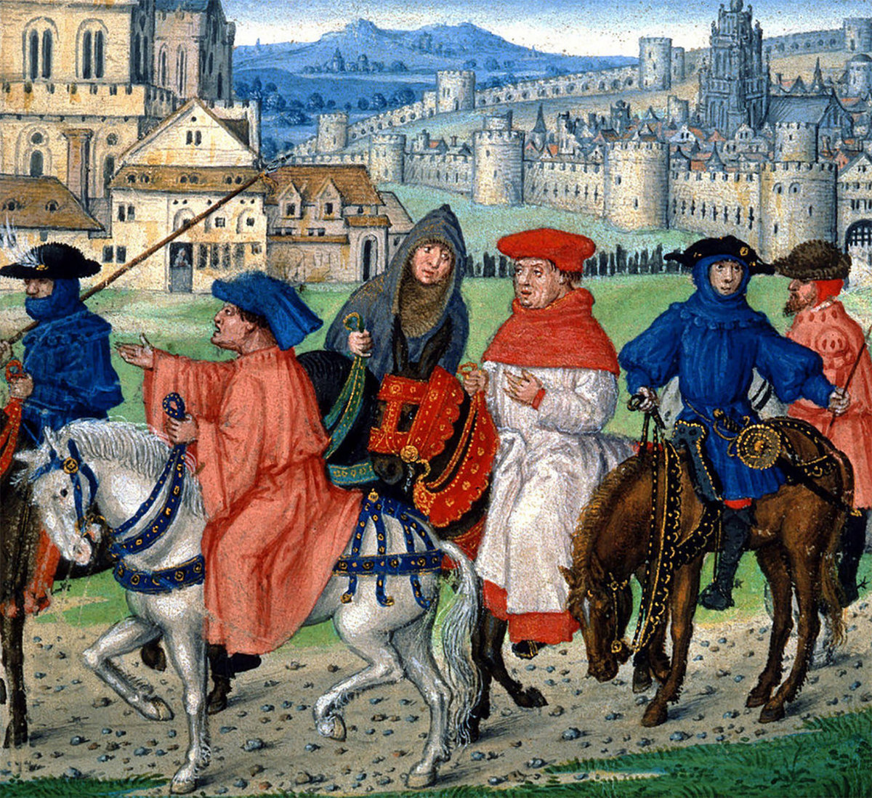
Middle English period
1066-1500

Slide 4
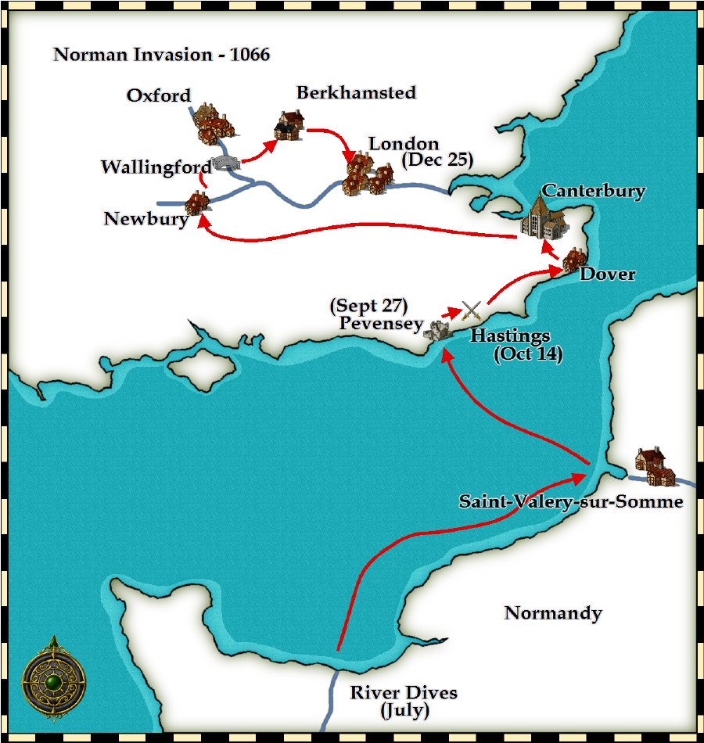
Middle English period
1066-1500
History
1066 King Edward the Confessor dies childless. Harold Godwinson (powerful English nobleman) and William of Normandy (who had been named as his successor by Edward) both claim the throne.
1066 Battle of Hastings is won by William “the Conqueror” of Normandy
French became language of higher circles of society, Anglo-Saxon English still spoken by common people
Literary characteristics
French influences
End rhyme instead of alliteration
More refined themes: courtly love instead of death, war and glory
More prominent position for women
Ideal is knight, not warrior
Ballads become popular, stories about King Arthur and his Knights of the round table
Literary works
  Geoffrey Chaucer’s The Canterbury Tales

Slide 5
Middle English period
1066-1500
  Chaucer’s The Canterbury Tales
  In The Canterbury Tales, a group of pilgrims traveling to Canterbury Cathedral compete in a storytelling contest. This overarching plot, or frame, provides a reason for the pilgrims to tell their stories, which reflect the concerns sparked by the social upheavals of late medieval England.

Slide 6


Slide 7
Middle English period
1066-1500
  Chaucer’s The Canterbury Tales
  Answer the questions on The Canterbury Tales in your reader

